Slide 1



Slide 2

GotSoccer
The largest software provider to the US Youth Soccer Market
Players
2.6 million players
Team Accounts
Coach, Managers, Officials Accounts
600,000 accounts
250,000 team accounts
College Coaches
Games Scheduled in last 12 months
Unique Users an hour on busy weekends
4,000 coaches
400,000 games
75,000

Slide 3
GotSoccer
In 2011…
Users will log in to GotSoccer 7 million times
GotSoccer.com will receive more than 250 million page hits
GotSoccer will continue to be the most visited website in the youth soccer market

Slide 4
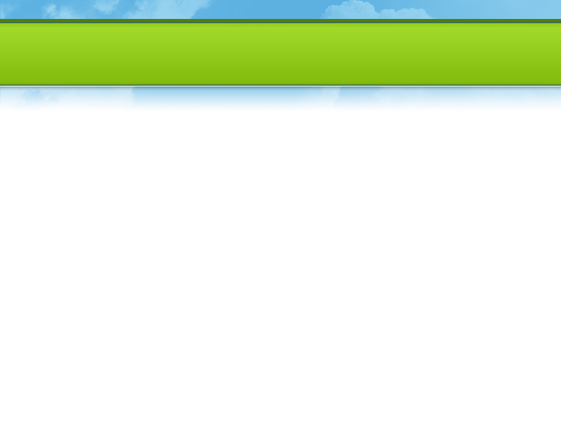





The Industry’s Best Client List
  Region 4

Slide 5


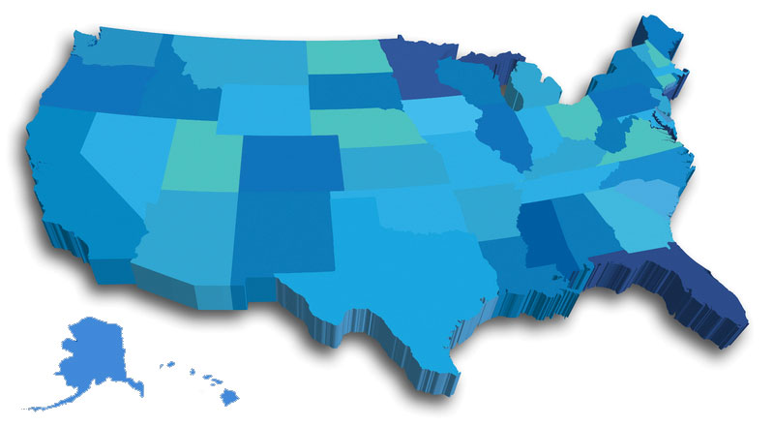
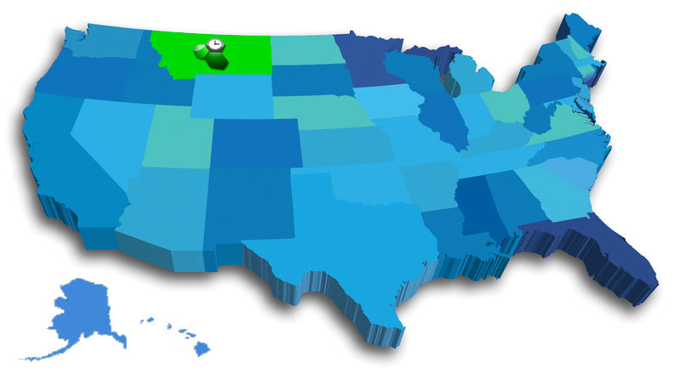
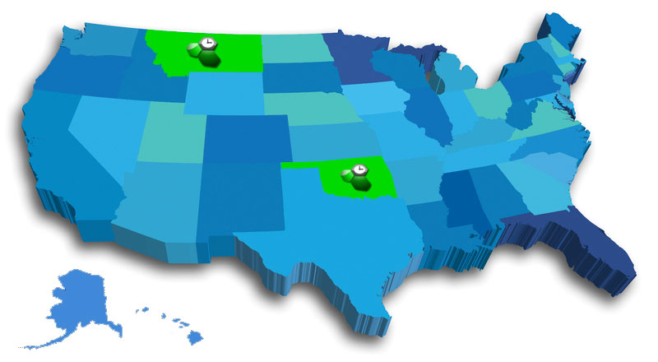

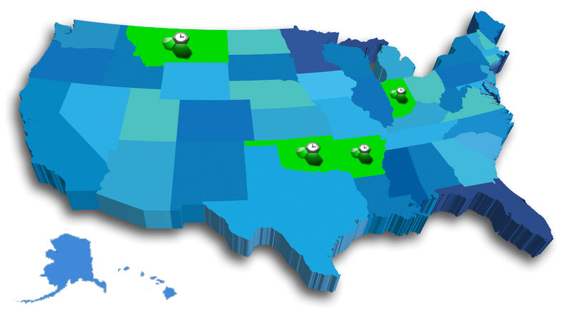
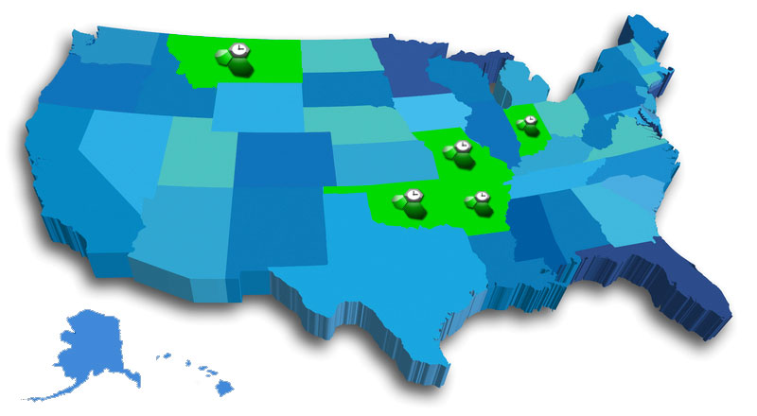
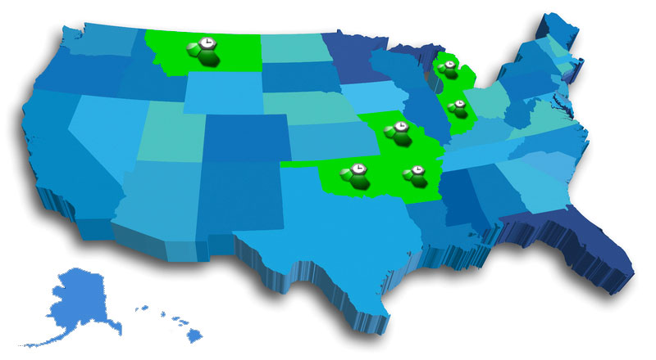

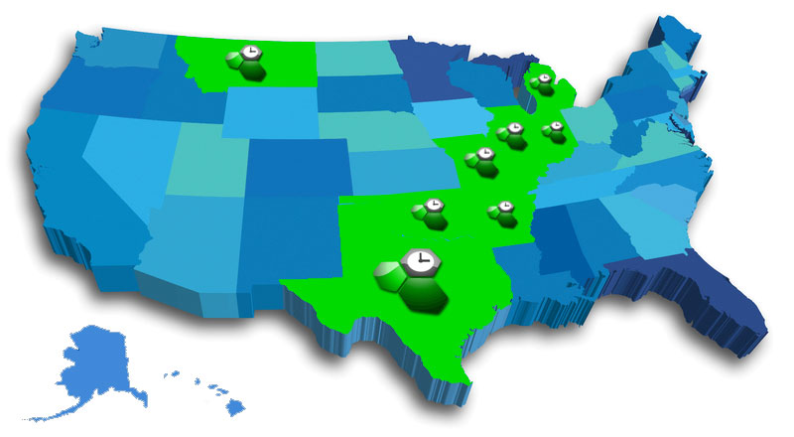


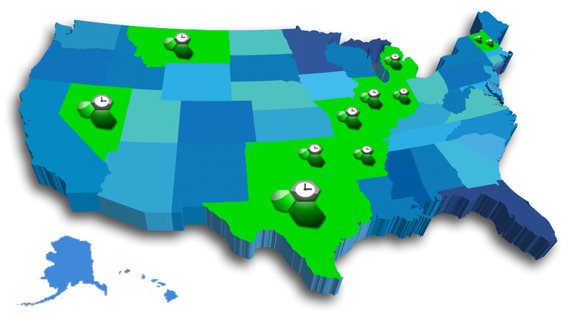


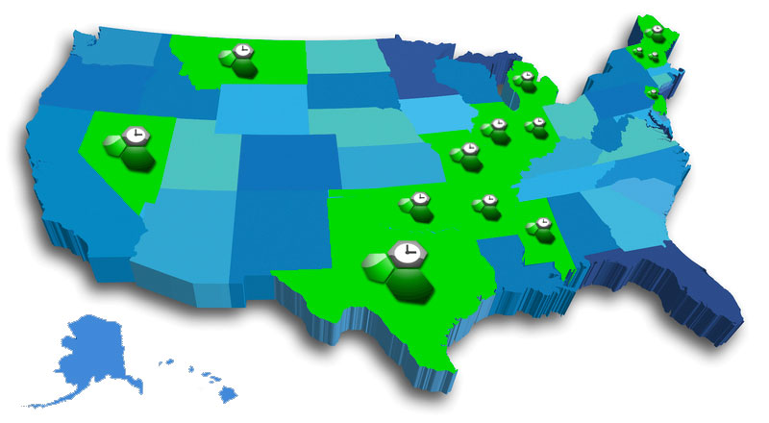
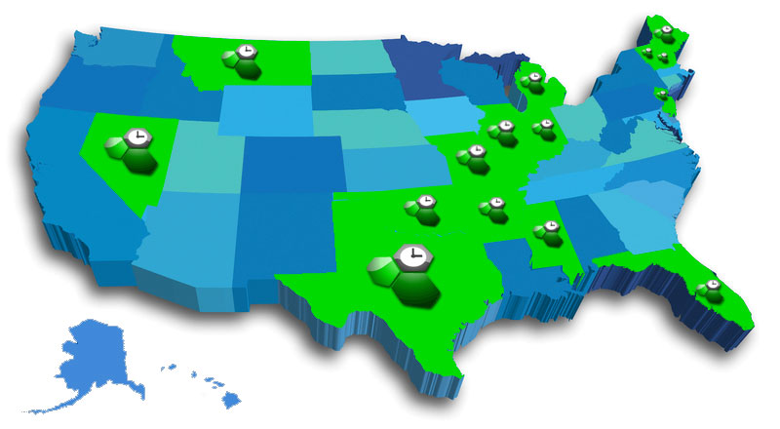
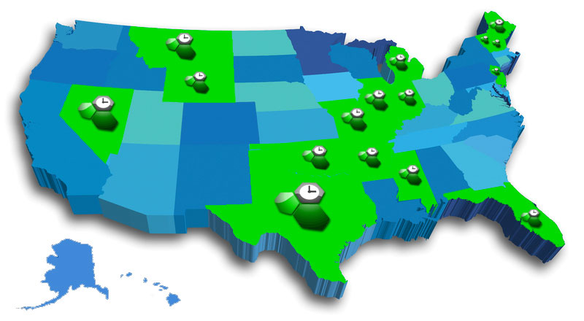


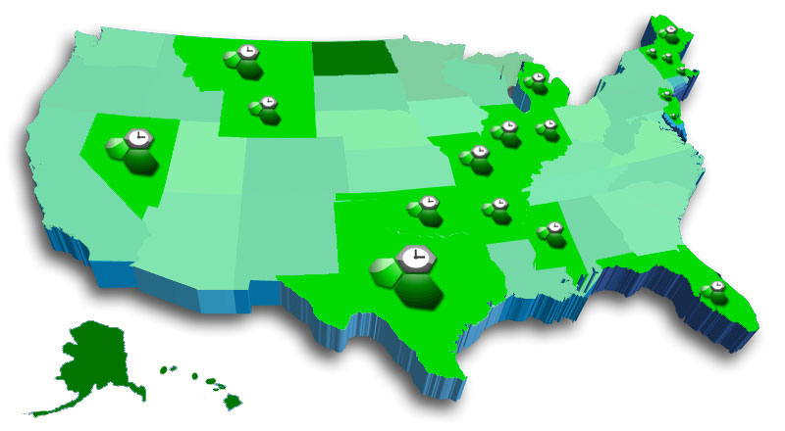
State Clients
GotSoccer Logo = GotSoccer State Client
Green Color = Heavy use of tournament/ league software

Slide 6
98% Client Retention Rate
22 state clients
1.5 million players will be carded and rostered using GotSoccer registrar module
850 tournaments with less than 2% turnover
400 online registration clients less than 2% turnover
No long term contracts

Slide 7
Browser Compatibility
Recommended Browsers:
  Internet Explorer
  Safari
  Chrome
You can also use
  FireFox
  Mozilla
(Certain Drag and Drop may not work with Firefox and Mozilla)

Slide 8
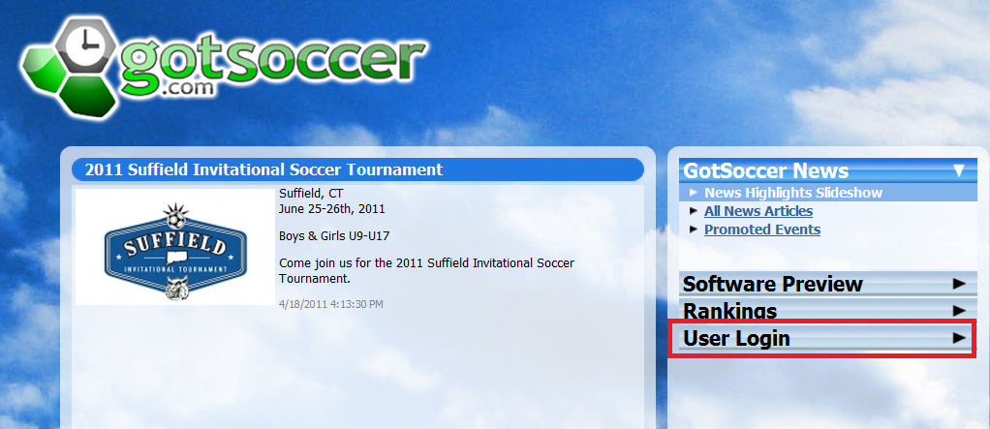
Logging In: www.GotSoccer.com

Slide 9
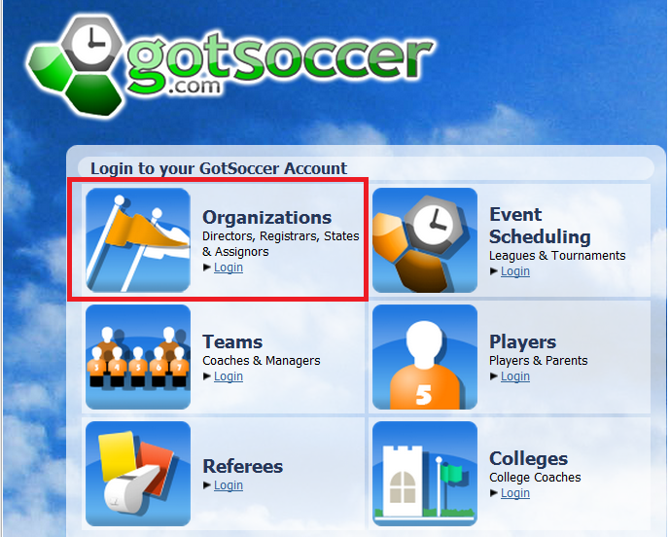
Clubs are Organizations

Slide 10
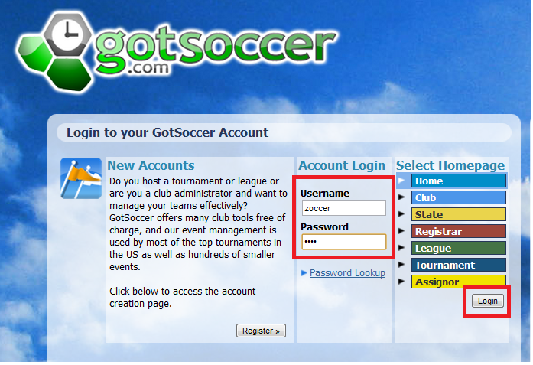
Logging In
If you do not have your username and Password Please contact CYS

Slide 11
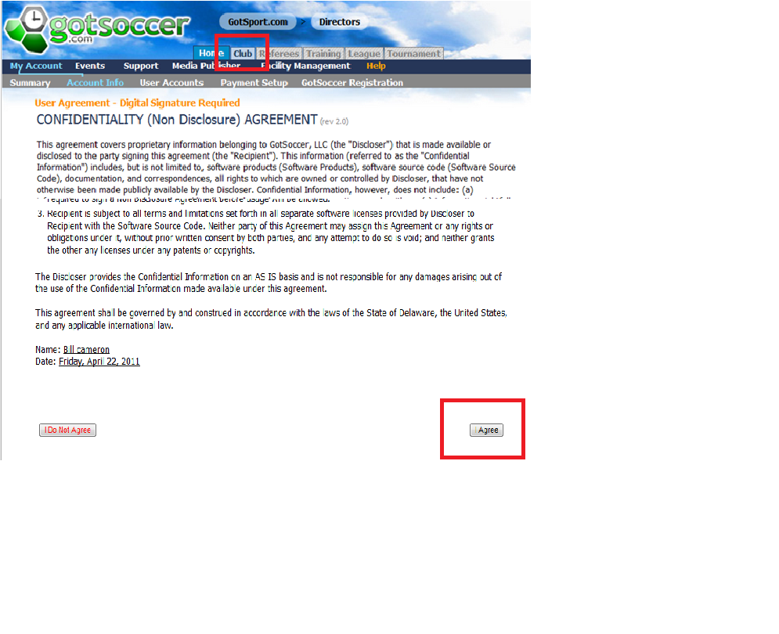
Confidentiality Agreement
You cannot give access to competitors!

Slide 12
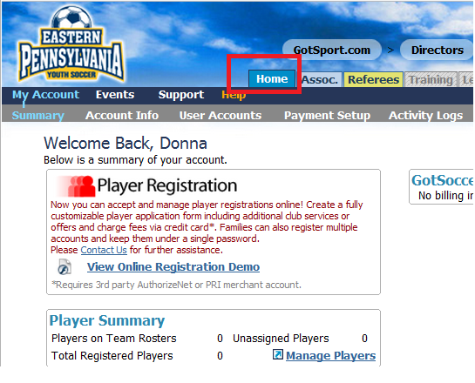
Home Area
  Account Info for Master User
  User Accounts for sub Users
  Payment Setup for credit card setup and mailing address for checks
  Activity Logs to see who emailed, made changes…

Slide 13
User Accounts
Recommended each user have their own account:
  Full Access – Can modify any user account
  Basic Access – Only allowed access to certain areas
  Limited – removes ability to make modifications in most areas.
  Allow access by tab, Event, Age Groups, Competitive levels and more.

Slide 14
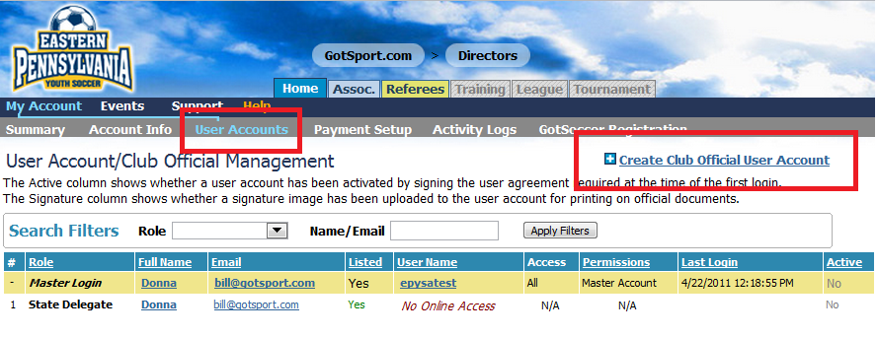
User Accounts

Slide 15
CYS may Required User Accounts
President
DOC
Your state will be able to access these individuals and send emails to them.

Slide 16
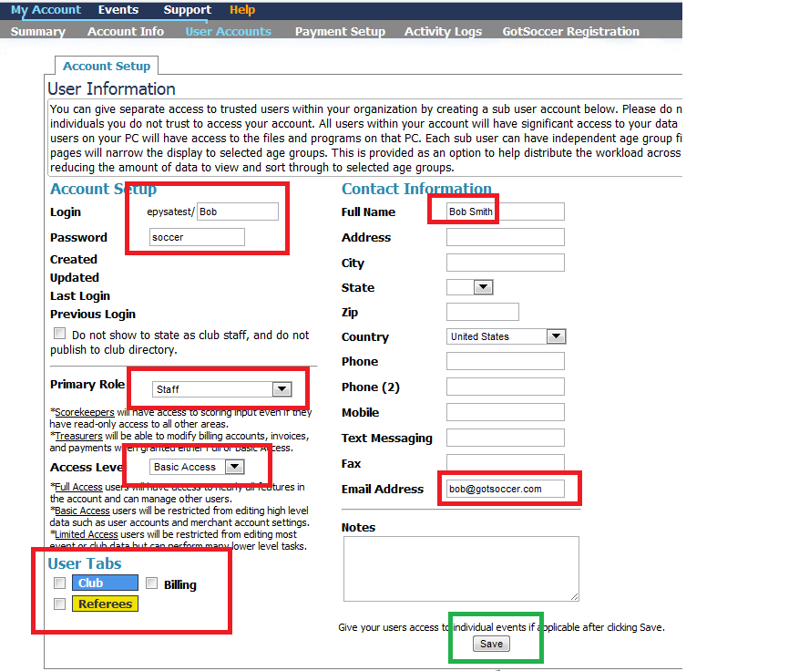
User Accounts

Slide 17
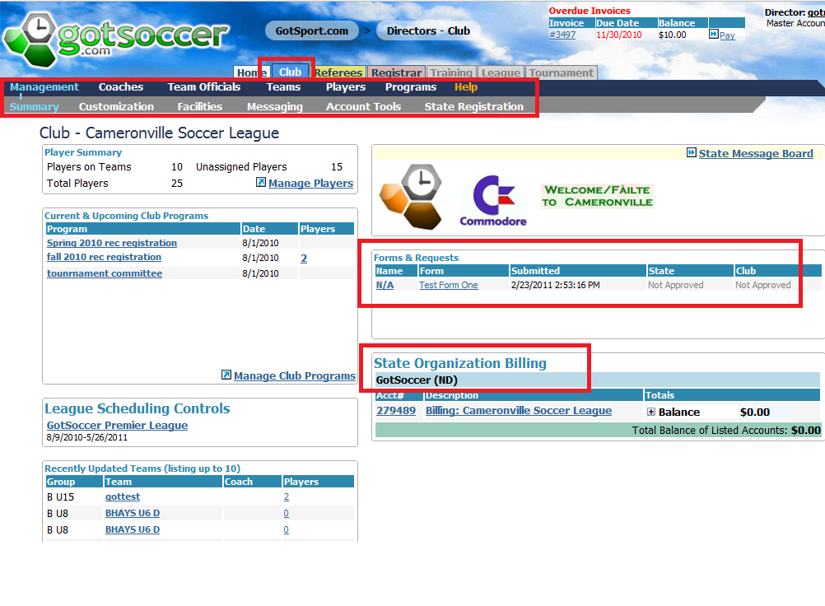
Club / Association Area
Overview

Slide 18
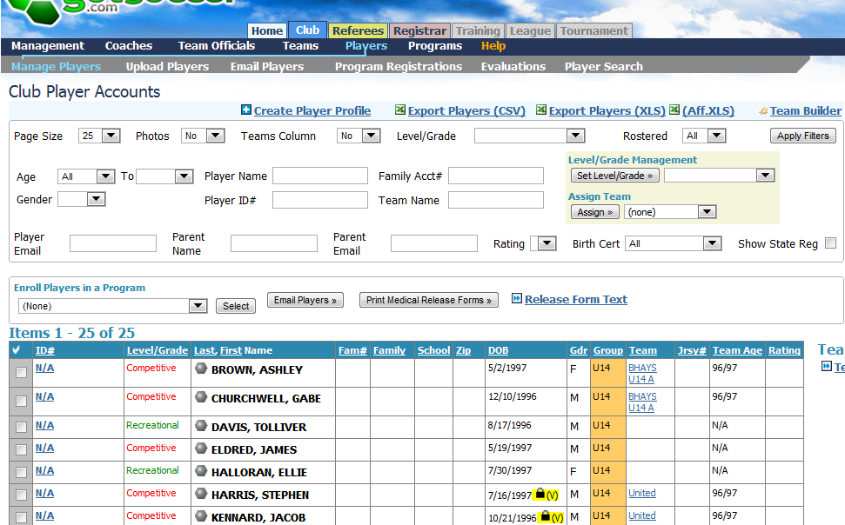
Club / Association Area
Sort, Report, Assign

Slide 19
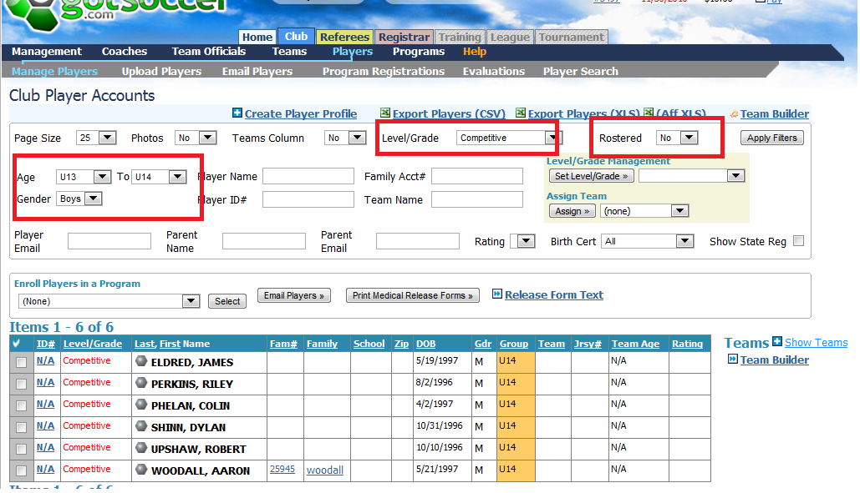
Sort / Report
Boys, U13 to U14, Competitive, Not Rostered

Slide 20
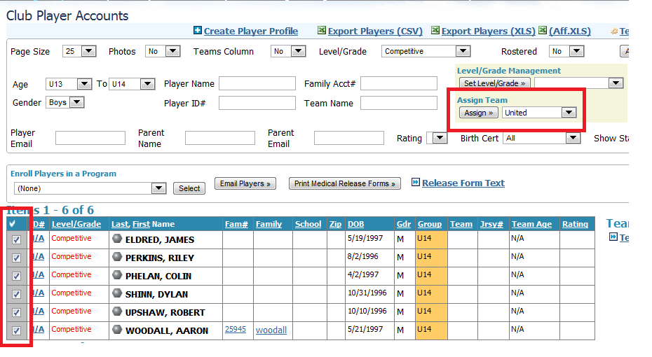
Assign
Assign these Players to a specific team, United
Assign these Players to a specific team, United

Slide 21
How to Populate the Club Space
Use our online Registration system
Upload information from a spreadsheet
Manually enter player information

Slide 22
Club Extended
The Club Extended program is optional. This is the one module we charge a fee. It allows:
Parents to register players with your club online
Electronic payments; credit card and echecks
Digital signatures on liability waivers…
Emailing to players and parents

Slide 23
Club Extended
Regarding electronic payments
GotSoccer does not touch client funds. We use a gateway that deposits funds in your bank account within 48 hours. Credit card processors charge a fee, a good estimate is 3% per transaction.

Slide 24
Spreadsheets
If you use paper registration or another online service you can upload players , create and amend team player lists with a spreadsheet.
The spreadsheet will require:
  First name
  Last name
  Gender
  Date of birth
  Competitive level
  Email address
  Street address
  Phone

Slide 25
Spreadsheets
  If you want the system to place players on teams you will also need:
  Team name
  Team gender (girls can play on boys teams)
  Team age

Slide 26
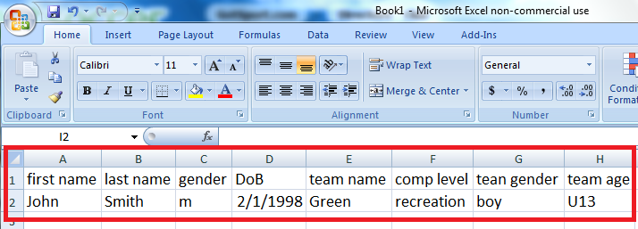
Sample Row

Slide 27
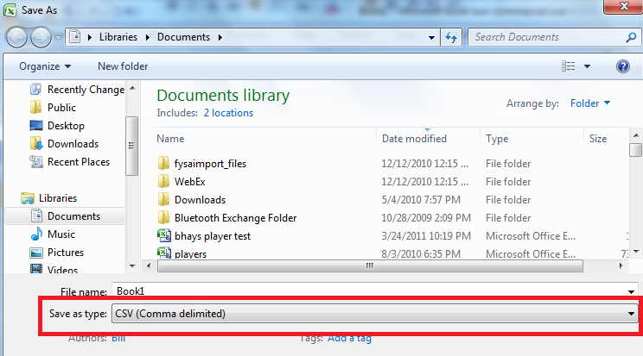
What’s a CSV File?
Don’t worry, it’s just a file type (comma, separated values)
Just click on “Save as” in Excel and select CSV

Slide 28
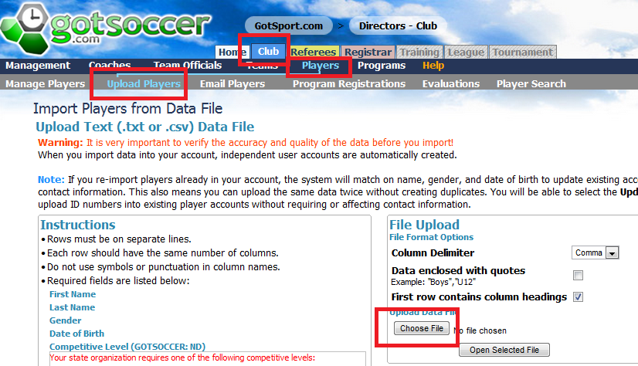
Club / Association Area
Go to the player tab and click on Upload players, then click the Browse or Choose file button and find the file on your computer and upload the file

Slide 29
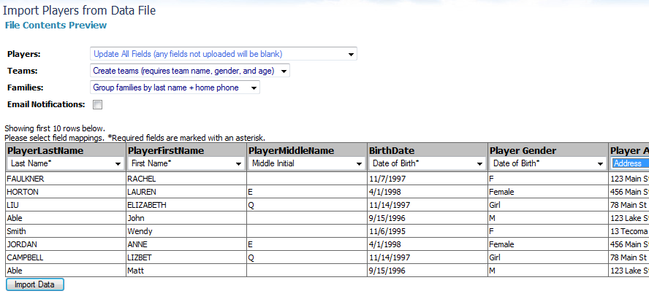

Club / Association Area
Easy upload ability using Excel and CSV files:
  You simply upload your CVS file
  2. Then match your fields to those in our database
Use our simple drop down menu to choose the correct fields

Slide 30
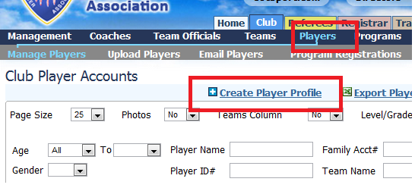
Manual Entry or the Hard Way!
In the Player area:
Click on Create Player
Enter the player information press Save
You can even assign a team

Slide 31
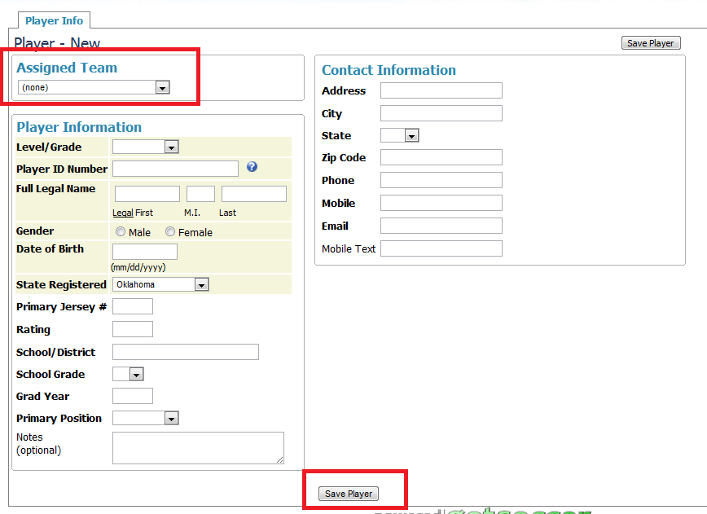
Manual Entry or the Hard Way!

Slide 32
b
Adding Teams
  Team Ages
It is critical that you understand teams stay in our system from year to year and we increment the “U” year on August 1 each year.
In this example, we selected a 98/99 which is a U12 in the 2010-2011 seasonal year.
On August 1, 2011 it will become a U13, of course it is still a 98/99. If you want a “U12” team for the fall and are making the team prior to 8/1, make it a U11 as we will increment it on 8/1 to U13.

Slide 33
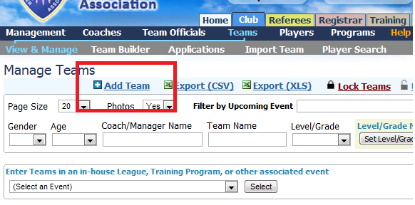
Add Teams
  If you need to add a team:
  Click on the Team link and
  Click Add team

Slide 34
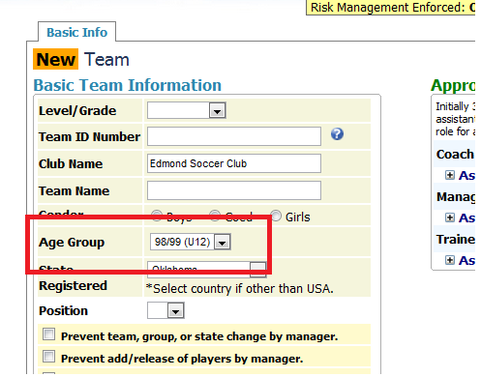
Add Teams
  We strongly suggest you use the birth year (98/99). If you do the age will always be correct.

Slide 35
Creating Teams
  There are several ways to build teams, we showed using a spreadsheet, here we show assigning players directly. We:
  Selected a gender and age group
  Selected not rostered players
  Selected the players
  Assigned them to a team

Slide 36
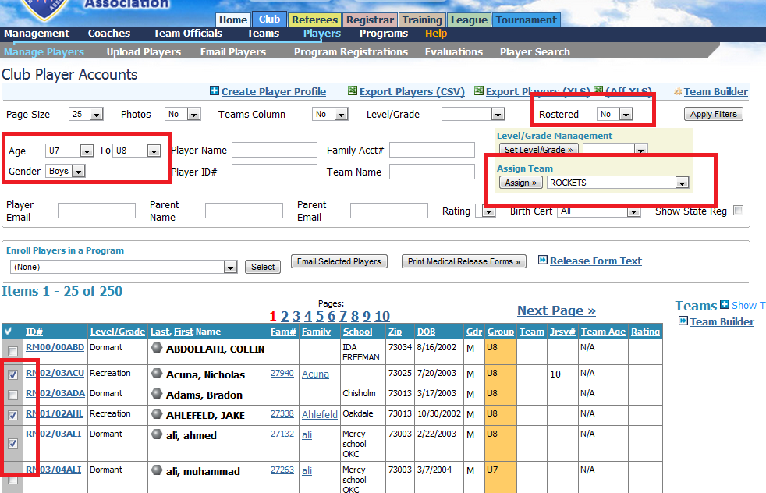
Creating Teams

Slide 37
Coaches
Coach accounts can also be uploaded via a spreadsheet, but you will not be able to place them on a team until your state’s Risk Management (Background checks) process has been completed.

Slide 38
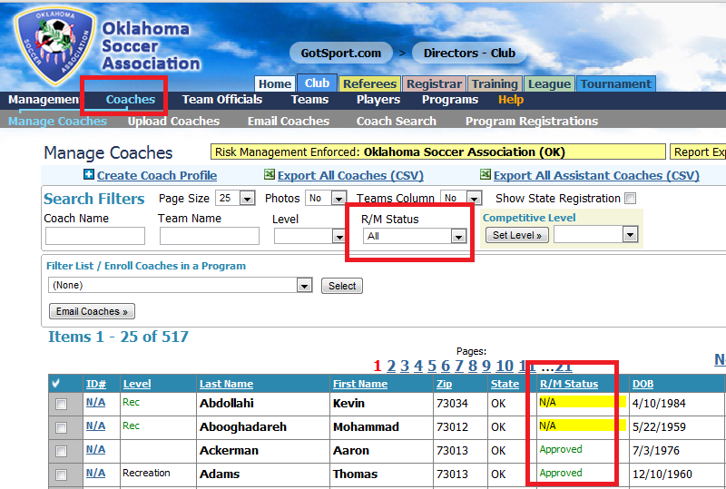
Coaches Sort / Report

Slide 39
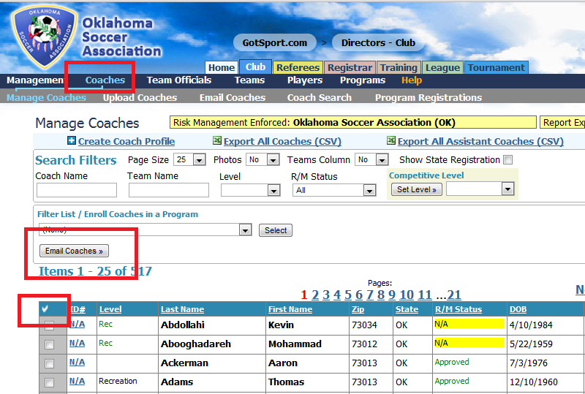
Email

Slide 40
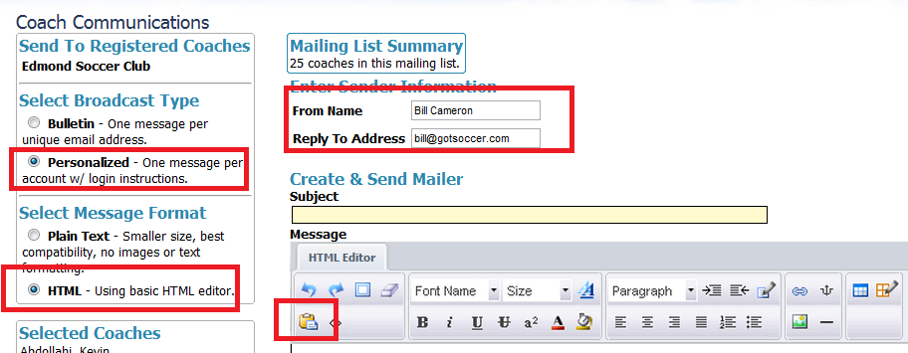
Email
  Send log in information
  Paste from Word
  Change the sender
  Send links…

Slide 41
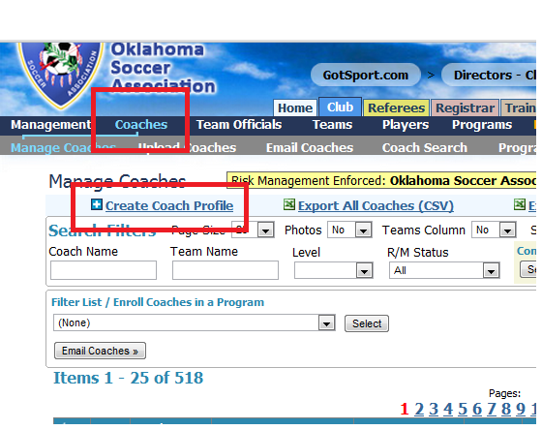
Creating a New Coach Account

Slide 42
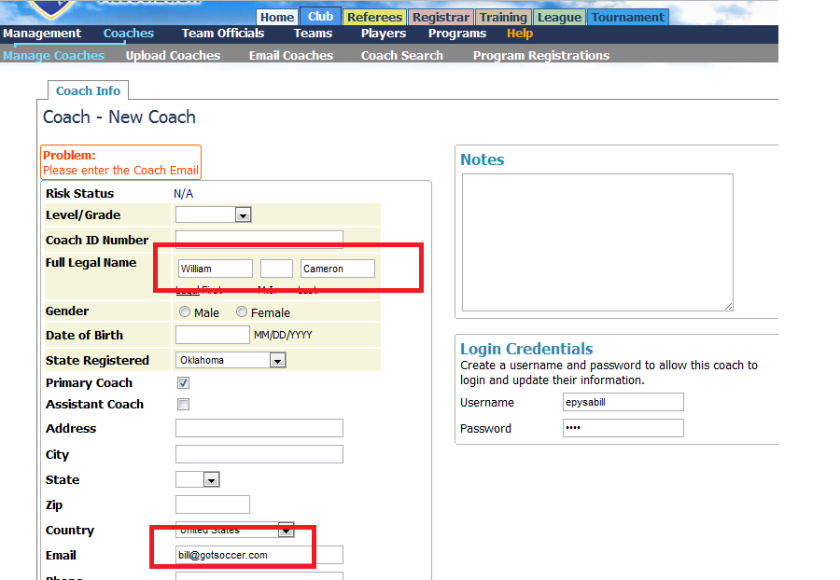
Fill out Basic Info

Slide 43
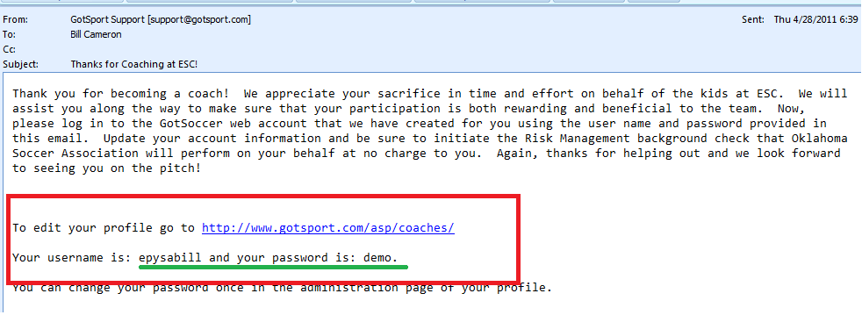
An Email is Automatically Sent
  The message can be customized
  It contains the username and password
  And the link to the login page

Slide 44
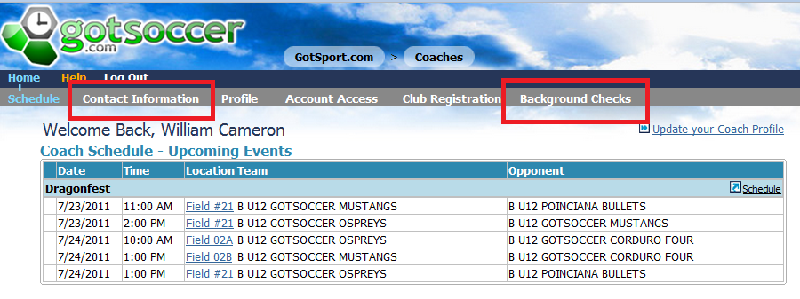
The Coach Account
  As the coach see’s it:
  Update Contact Information
  Complete the Background check

Slide 45
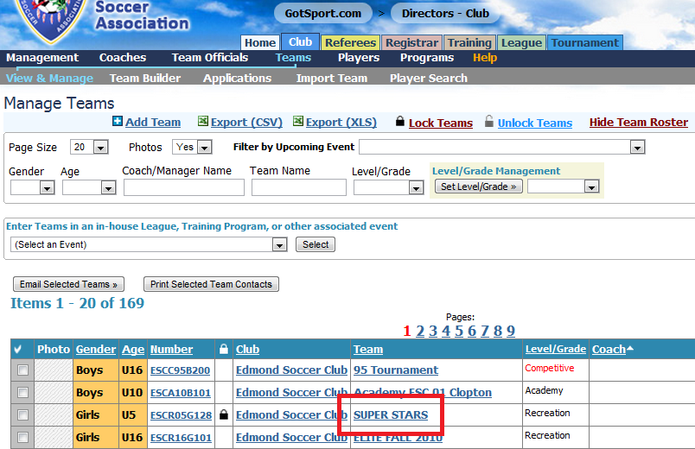
Placing Coaches on Teams
  Go to the Team area
  Click on a Team Name

Slide 46
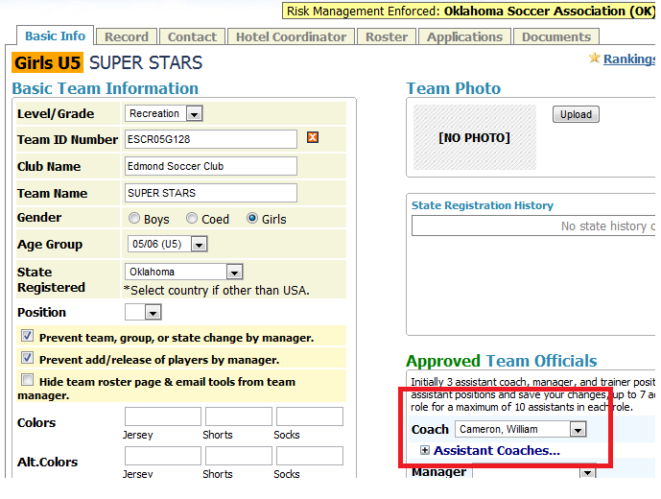
Placing Coaches on Teams
  Select a coach from the dropdown
  Only Approved coaches will appear

Slide 47
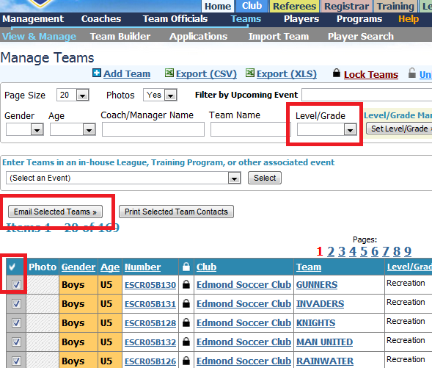
Email Teams
  Sort
  Select
  email

Slide 48
Email Teams
  Send log in information
  Paste from Word
  Change the sender
  Send links…

Slide 49
The Registration Process
  “Registration” = Telling your state these players will be playing this seasonal year and what competitive level they will play
  This is not the process of carding and rostering players.

Slide 50
The Registration Process
  The keys:
  All players, teams and coaches will be set to “Not Registered” This means you start at a zero invoice state
  You must designate players, teams and coaches as Competitive, recreational (or categories recognized by your state)

Slide 51
The Registration Process
  To make this easy:
  Place players on teams
  Place coaches on teams
  Set teams competitive levels as any player on a team will get that teams level (Competitive, Travel, Recreation…)

Slide 52
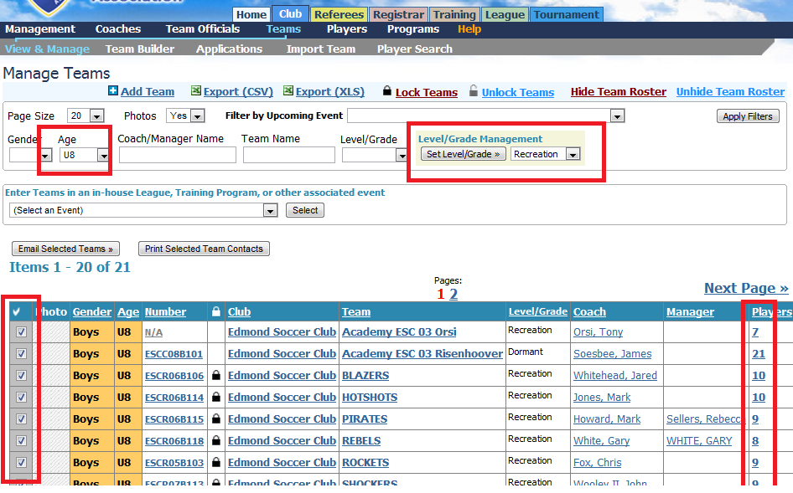
The Registration Process

Slide 53
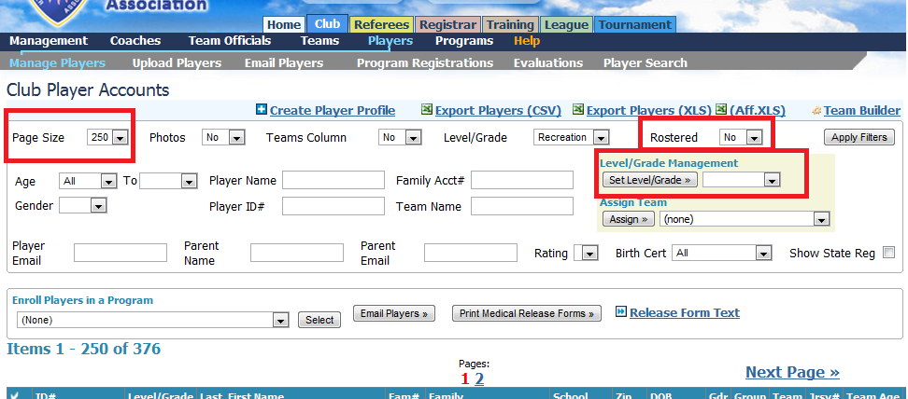
Make Sure all is Correct
  This assumes those not rostered should not be registered

Slide 54
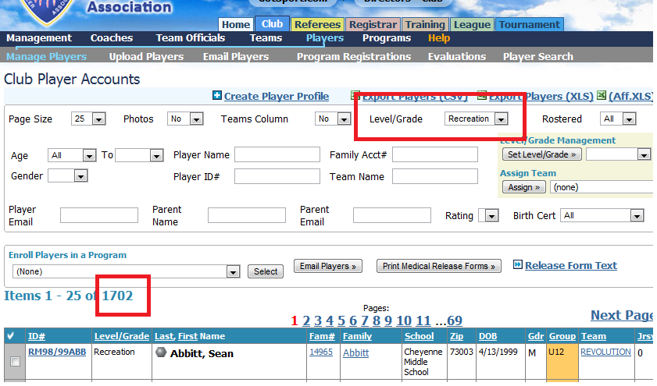
How Many?

Slide 55
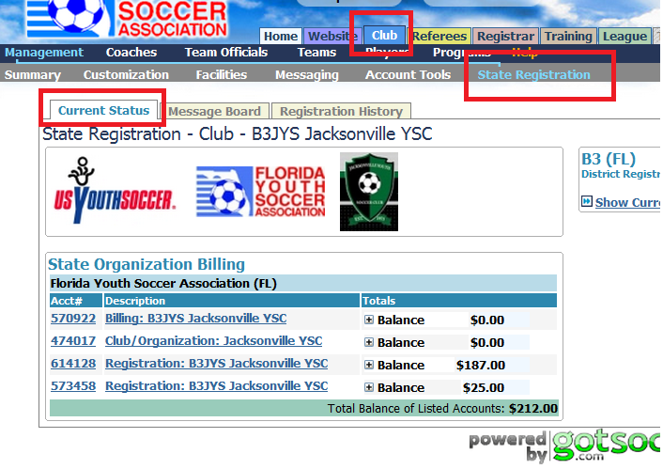
Where to find your State Invoices

Slide 56
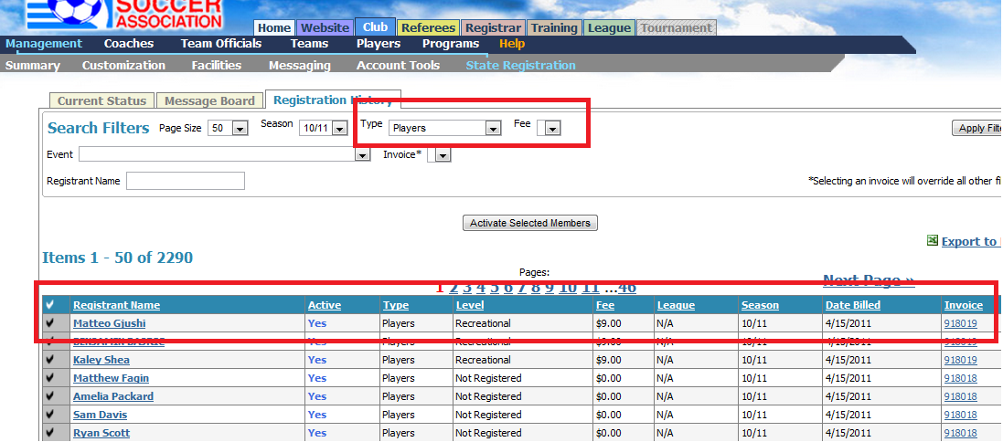
Where to find your State Invoices

Slide 57
Entering Teams in a League
  The keys:
  Go to the Teams area
  Select the League from the dropdown (Enter Teams in an in-house league…)
  Select the teams (sort, report…)
  Enter the teams
  Remember you are giving viewing rights, not copying teams

Slide 58
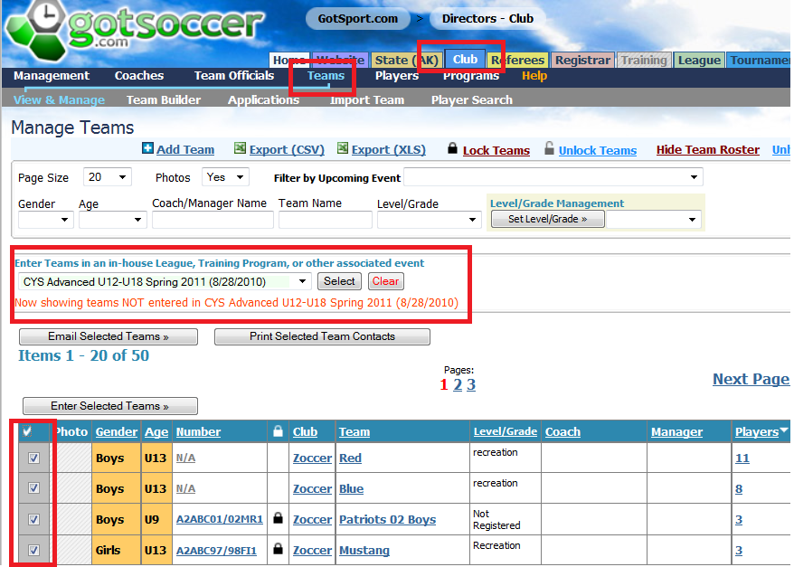
Entering Teams in a League

Slide 59
Entering Teams in a League

Slide 60
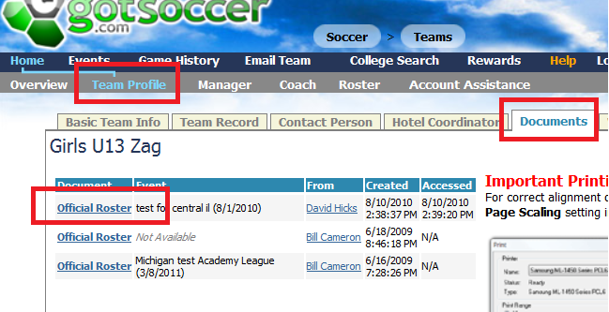
Fr
Downloading Rosters
  From your team account,
  Click Team Profile, then Documents

Slide 61

Fr
Print Game Cards
  From your team account,
  Then the event

Slide 62
Fr
Print Game Cards
  From your team account,
  Then the event

Slide 63

Fr
Print Game Cards
  Click on Schedule,
  Then the PDF icon to get a game card

Slide 64

Fr
Phone in Scores

Slide 65

From your smart phone:
Go to www.gotsoccer.com
Click on the Scoring link
Entering Scores
  Use a smart phone www.gotsoccer.com

Slide 66

Real Time Results

